Slide 1
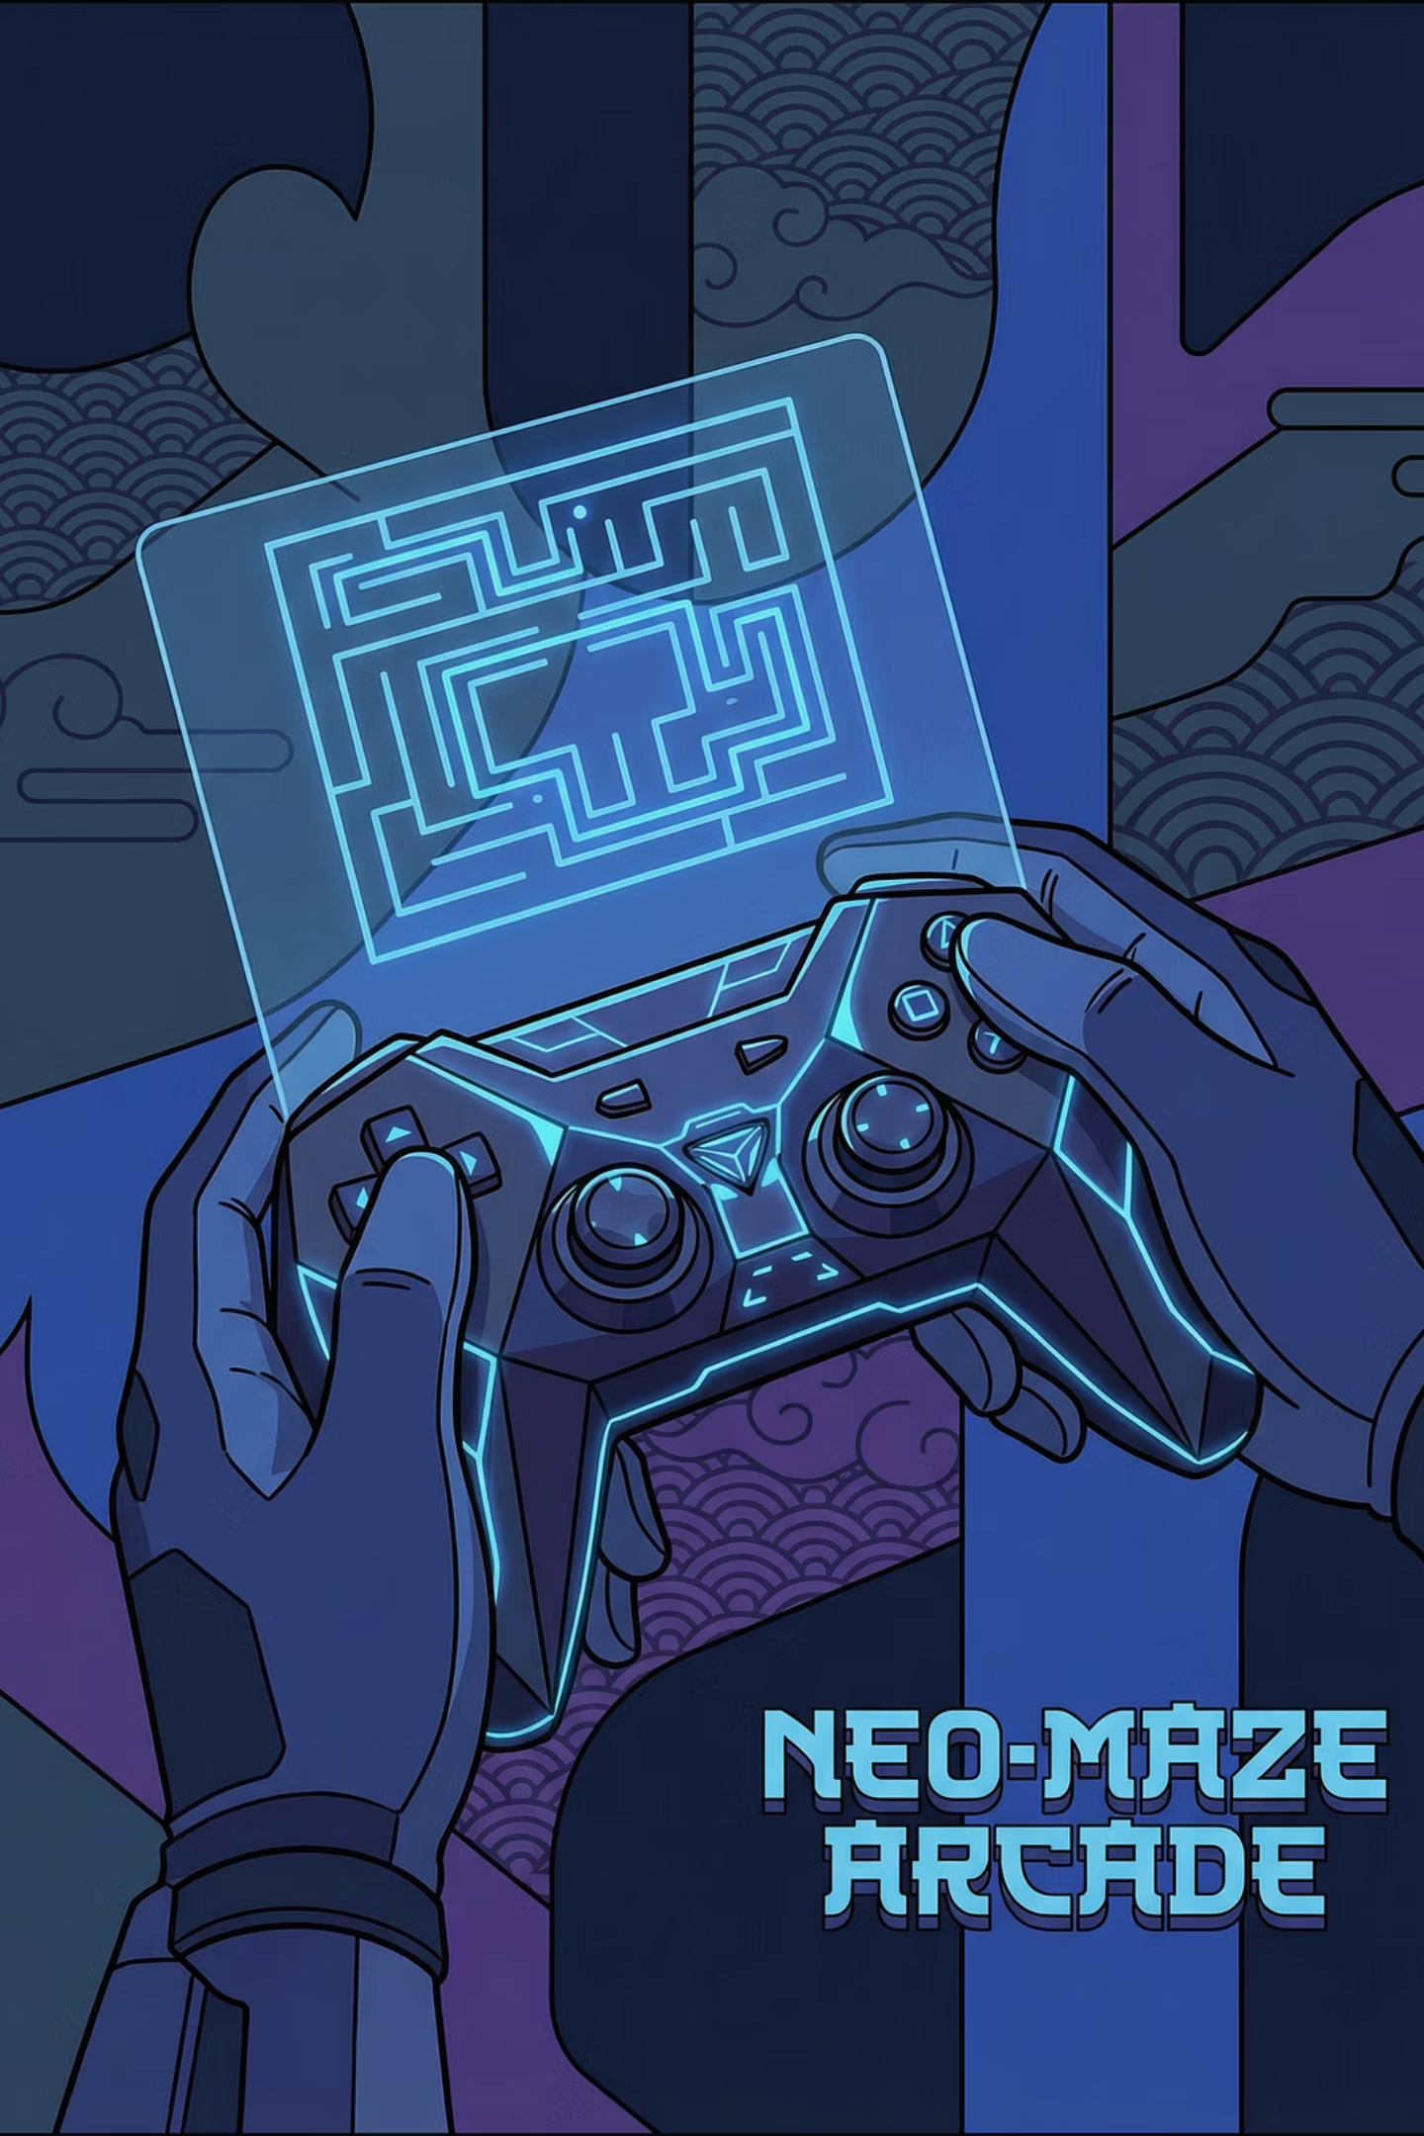
The iMAZEing Box: A Wireless Embedded Game System
Greetings, esteemed engineers and developers! We are thrilled to introduce you to "The iMAZEing Box," a bespoke, motion-controlled gaming marvel. Our paramount goal was to engineer a fully decoupled, wireless game controller and console, leveraging the robust capabilities of PSoC 6 microcontrollers and the efficiency of FreeRTOS. Prepare to delve into the intricate design and innovative solutions that underpin this exciting embedded system.

Slide 2
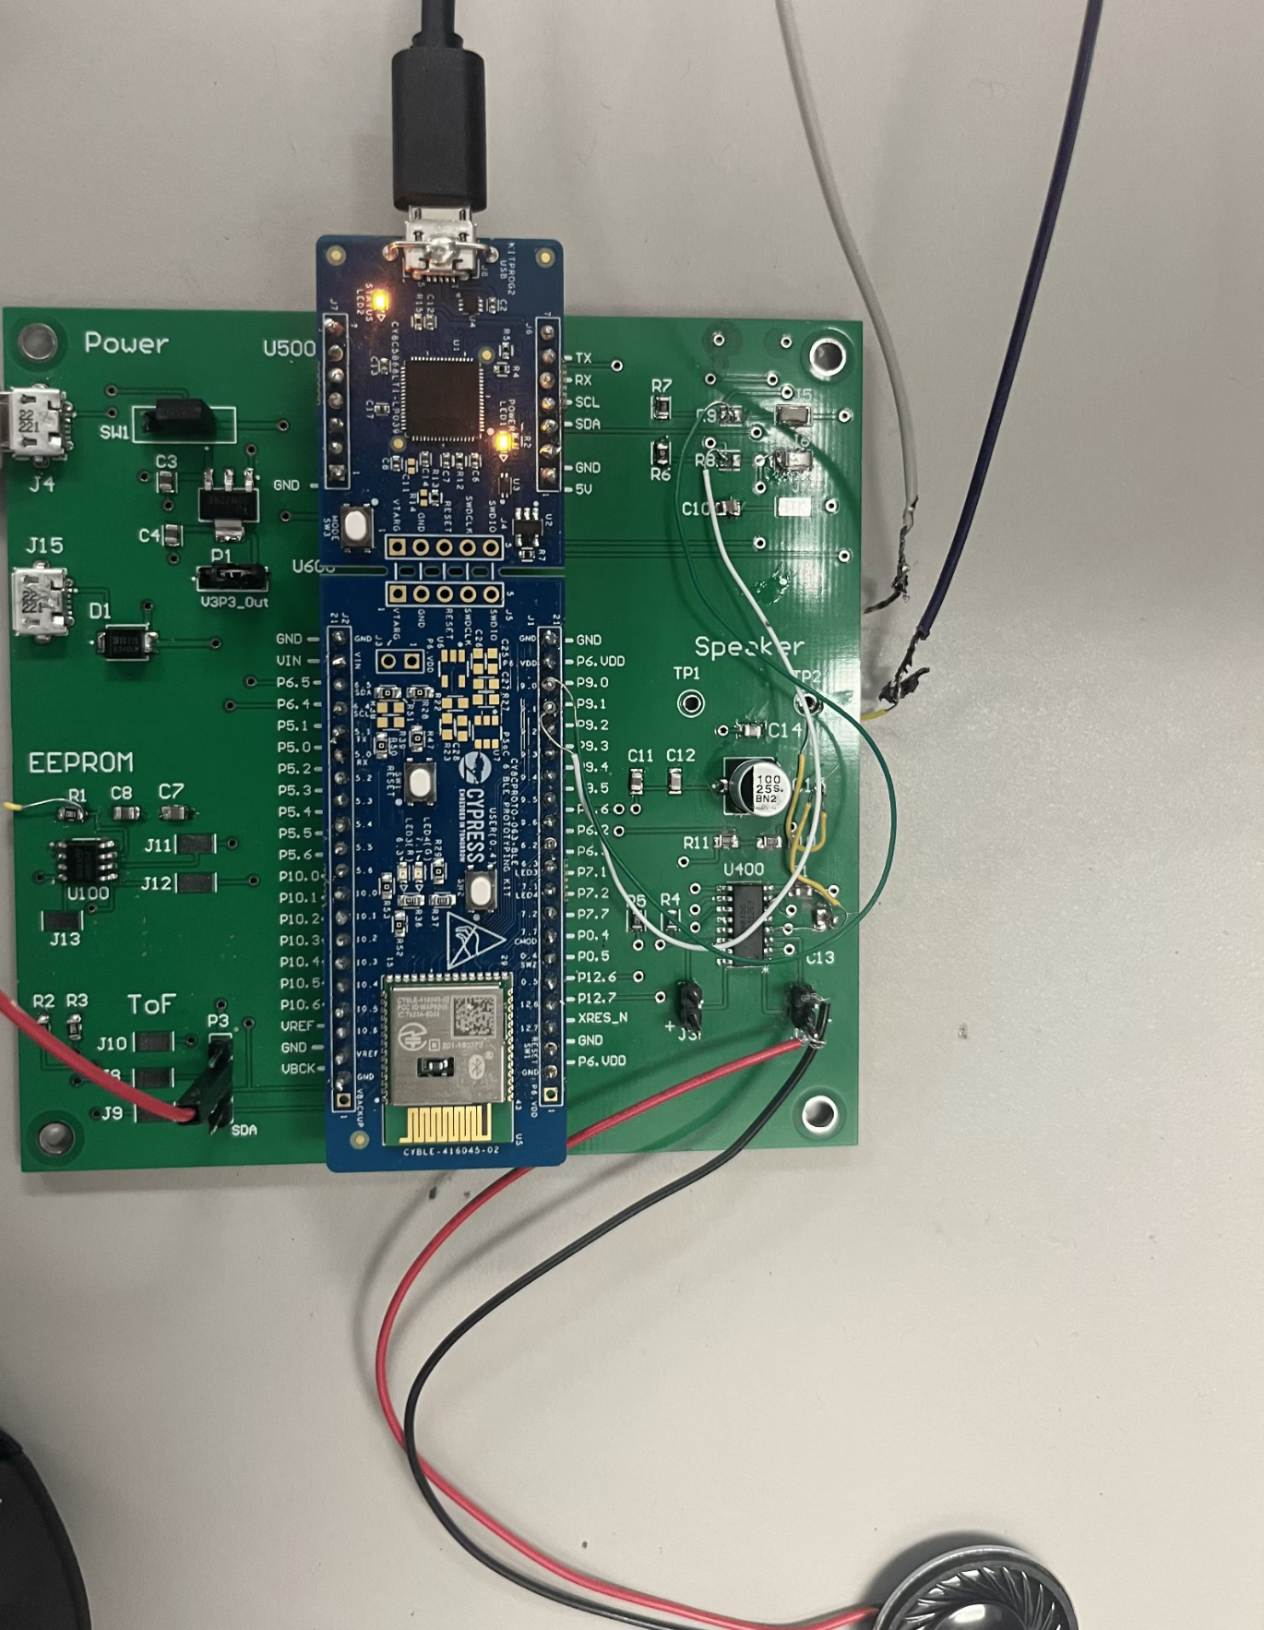
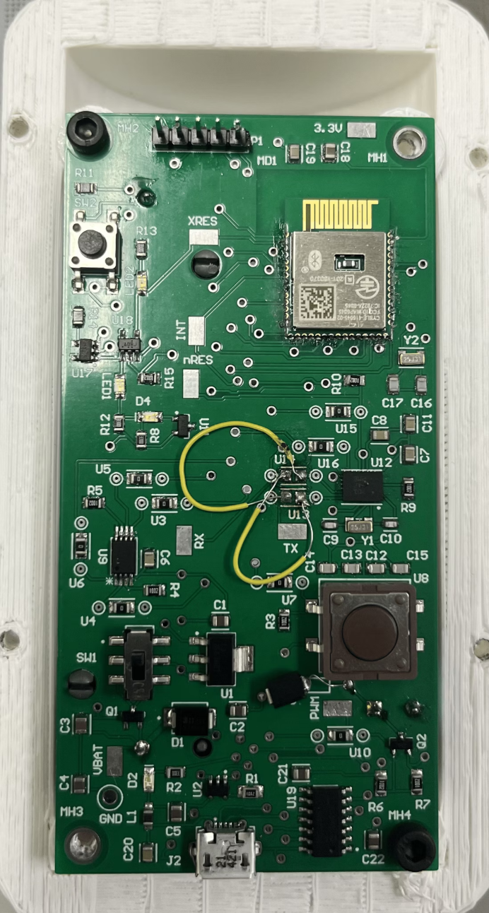
Console
Controller

Slide 3
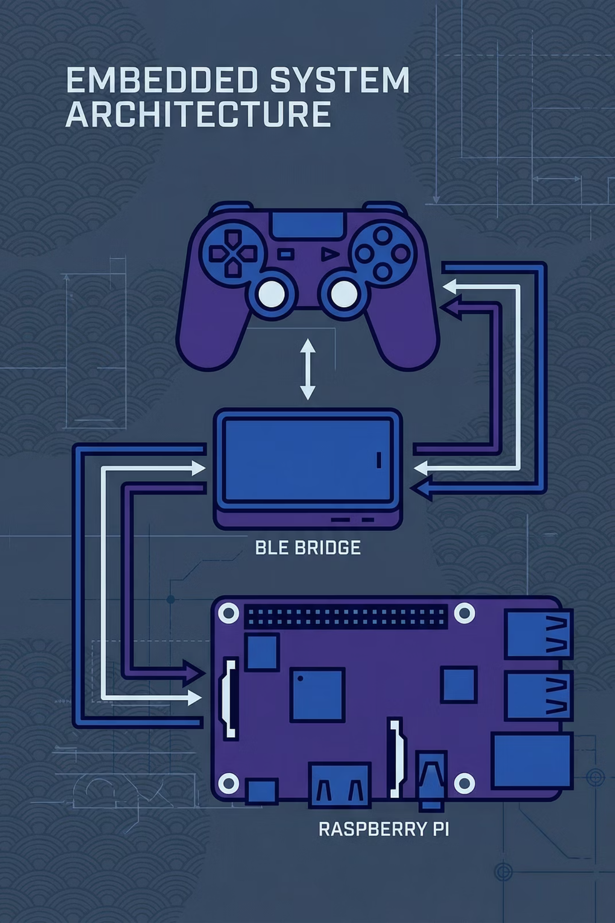



Unveiling the Core Architecture
At the heart of The iMAZEing Box lies a meticulously crafted, three-tiered system architecture, designed for seamless communication and unparalleled responsiveness.
The Wireless Controller
A sleek, battery-powered PSoC 6 unit, featuring 9-DOF motion sensing and immersive haptic feedback.
The Console Bridge
A PSoC 6 base station acting as the vital BLE Central bridge, ensuring reliable data transfer.
The Game Engine
A Raspberry Pi 5, orchestrating the gaming experience with a Python/Pygame interface via UART.

Slide 4
The Intelligent Communication Flow
Experience the intricate dance of data that brings The iMAZEing Box to life. From user motion to on-screen action, every step is precisely choreographed for a truly immersive experience.
01
02
User Motion Input
IMU Data Acquisition
Physical gestures from the player initiate the command sequence.
The Inertial Measurement Unit (IMU) precisely captures 9-DOF orientation data.
03
04
BLE Notification
Console Bridge
Encrypted motion data is transmitted wirelessly via Bluetooth Low Energy.
The Console PSoC receives, processes, and prepares data for the game engine.
05
06
UART Stream
Python Game Engine
Data is serialized and streamed to the Raspberry Pi for game logic processing.
The game visualises player actions and calculates real-time responses.

Slide 5
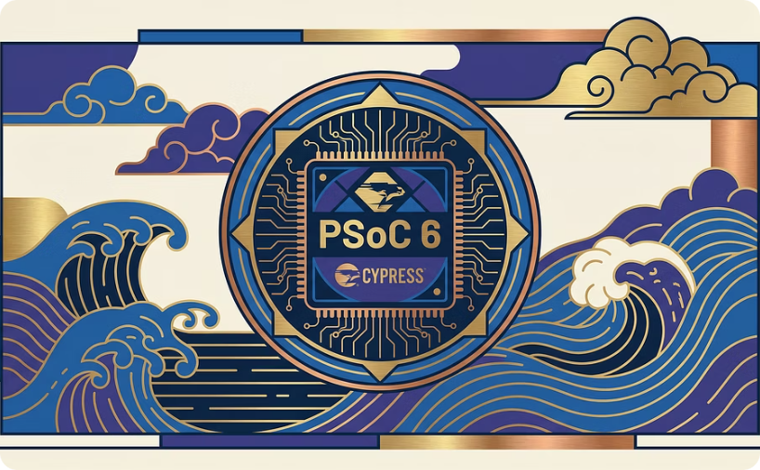
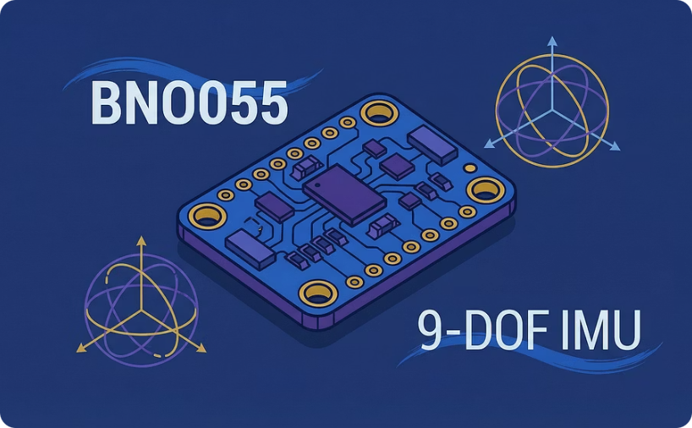
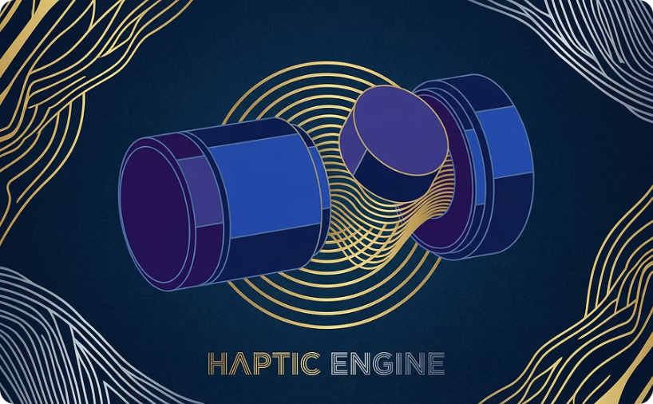
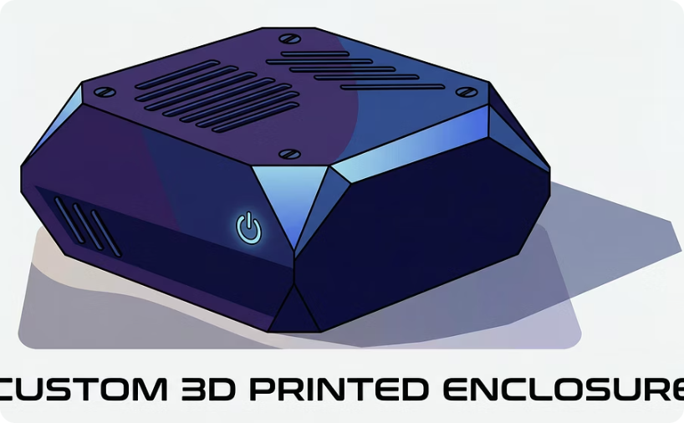
Controller Hardware: An Engineering Deep Dive
Our controller is a testament to meticulous engineering, designed to offer intuitive control and tactile feedback. Every component has been selected for optimal performance within a compact, ergonomic form factor.
PSoC 6 BLE Microcontroller
BNO055 9-DOF IMU
DC Vibration Motor
Custom Enclosure
A high-precision absolute orientation sensor, providing accurate motion tracking for an immersive gaming experience.
PWM-controlled haptic feedback for realistic sensations during collisions and in-game events.
Ergonomically designed and 3D-printed, housing all components securely and stylishly.
The brain of the controller, offering robust processing power and integrated Bluetooth Low Energy connectivity.
Additional features include an integrated Lithium-Ion battery circuit for extended gameplay and EEPROM for persistent storage of user settings.

Slide 6
Robust Controller Software: FreeRTOS Architecture
The controller's software, built upon FreeRTOS, ensures efficient task management and real-time responsiveness. This multi-threaded approach guarantees smooth operation even under demanding conditions.
Task_IMU: Sensor Data Acquisition
Task_BLE (Server): Wireless Communication
Task_Motor: Haptic Feedback Control
Dedicated task for reading 9-DOF orientation data at a consistent 50Hz, packaging it into a custom struct for further processing.
Manages Bluetooth Low Energy operations, broadcasting "Game Data" via GATT Notifications and listening for "Haptic Commands" from the console.
An interrupt-driven Queue system that precisely controls vibration intensity and duration, triggered by incoming commands.
Key Challenge: Thread-Safe Haptics
A significant engineering hurdle involved implementing a thread-safe Queue. This ingenious solution allows the BLE stack to trigger haptic feedback without obstructing critical sensor readings, maintaining seamless real-time performance.

Slide 7
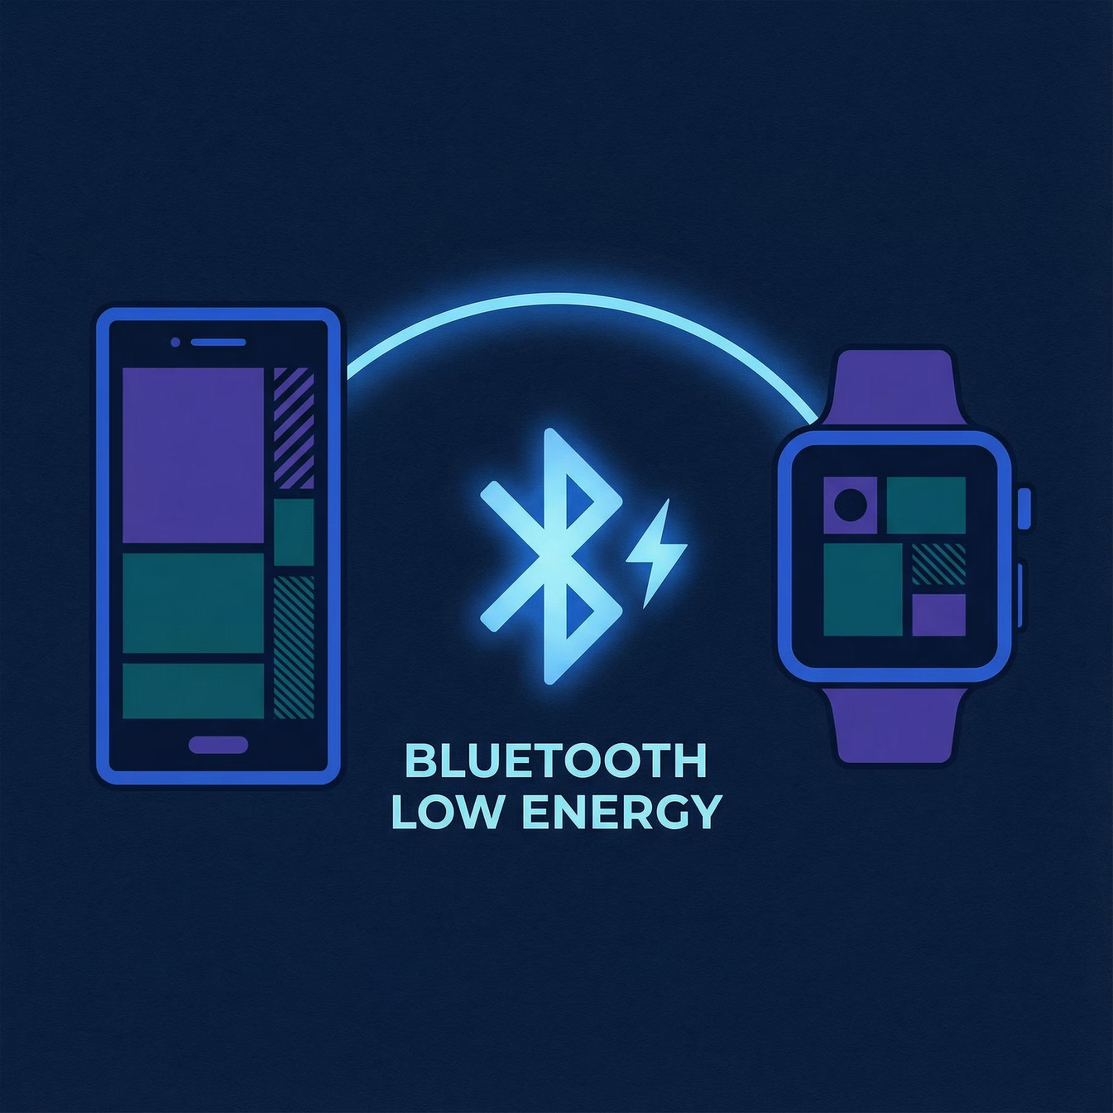
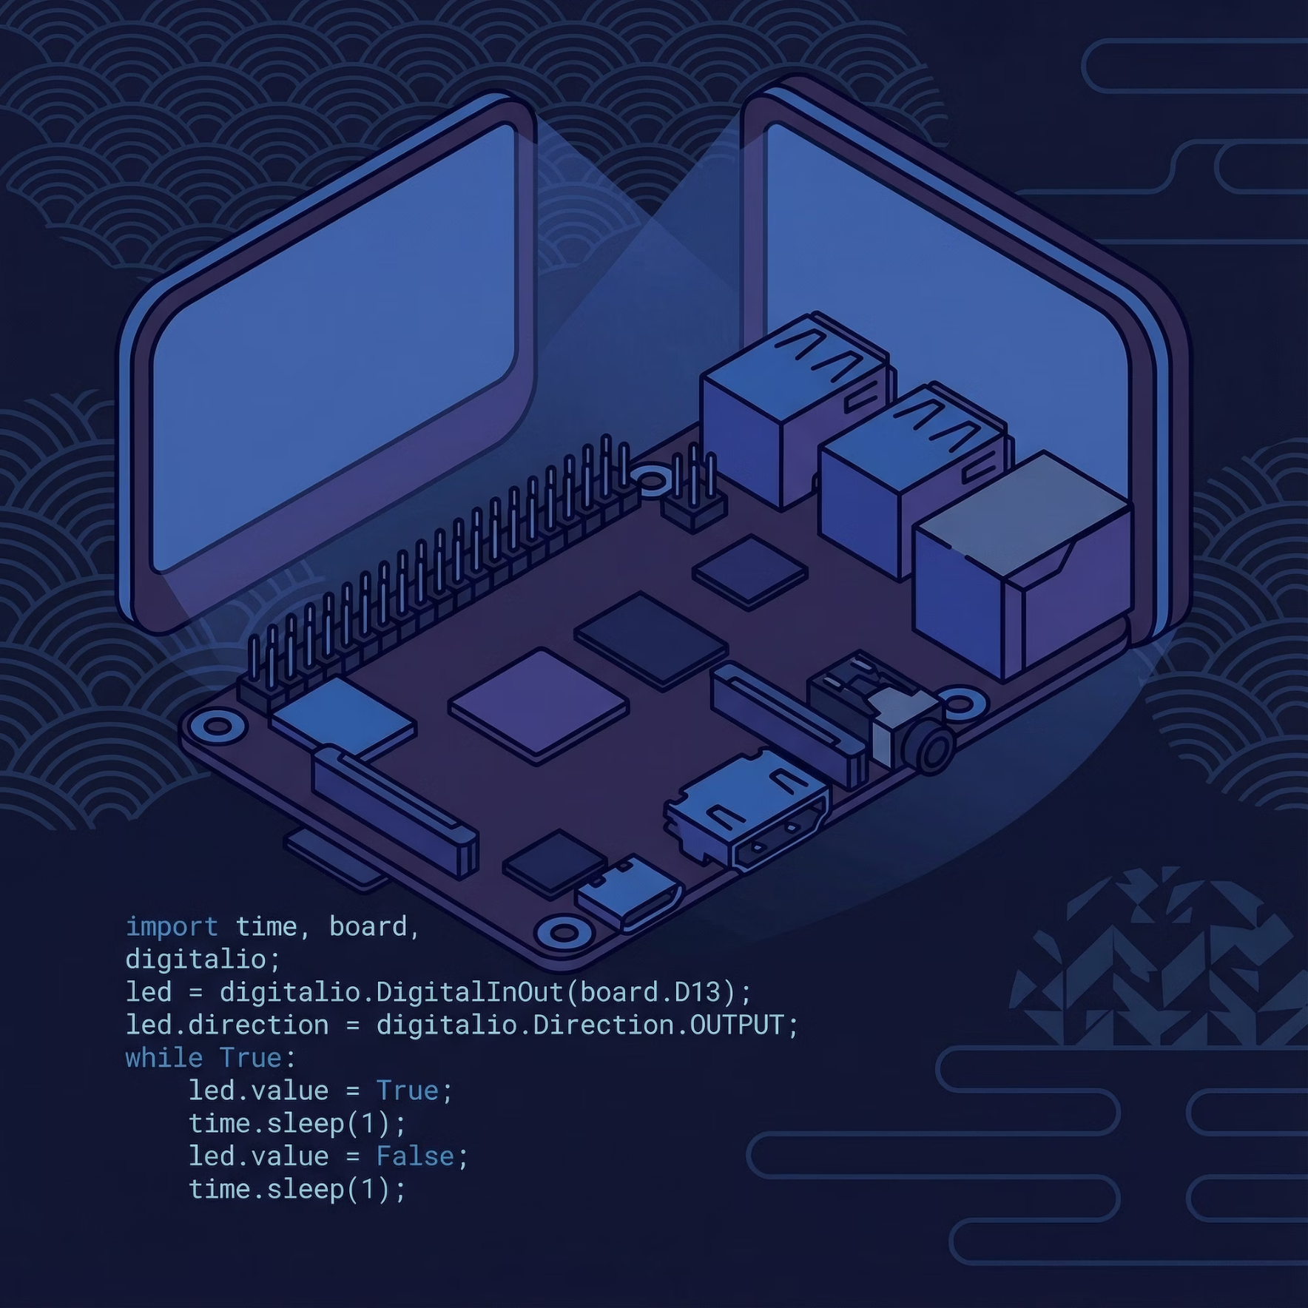
The Console & Game Logic: Bridging Real-time Action
The console serves as the crucial intermediary, translating wireless signals into engaging gameplay and providing additional sensory enhancements to the iMAZEing Box experience.
The BLE Bridge Functionality
Python Game Engine Integration
The Console PSoC diligently scans for the controller.
A Python script on the Raspberry Pi reads the UART stream.
Establishes an automatic and reliable connection.
Updates the graphical user interface (GUI) in real-time, mirroring controller movements.
Serialises incoming BLE packets into a continuous UART stream.
Sends collision flags back down the pipeline, triggering haptic feedback on the controller.

Slide 8
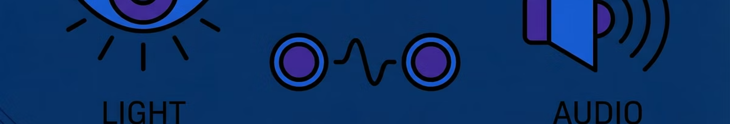



Enhancing Immersion: Additional Console Sensors
Beyond its primary bridging role, the console is equipped with a suite of auxiliary sensors, designed to enrich the gaming environment and introduce dynamic elements into the iMAZEing Box experience.
Ambient Light Sensor
Time-of-Flight (ToF) Sensor
Audio Amplifier Integration
Dynamically adjusts game visuals or introduces environmental effects based on ambient light conditions.
Enables gesture recognition or proximity-based interactions within the game, adding a new layer of control.
Enhances the auditory experience with dynamic sound effects and background music, fully immersing the player.

Slide 9

Project Outcomes: A Triumph of Wireless Engineering
The iMAZEing Box project successfully demonstrates the power of integrated embedded systems, achieving crucial milestones that validate its innovative design and robust implementation.
100%
<10ms
Seamless
Wireless Reliability
Low Latency
Robustness
Achieved full, uninterrupted wireless communication, proving the robustness of our BLE implementation.
Delivered real-time gameplay with imperceptible lag, crucial for motion-controlled experiences.
The system gracefully handles connection dropouts and automatically recovers, ensuring continuous gameplay.

Slide 10
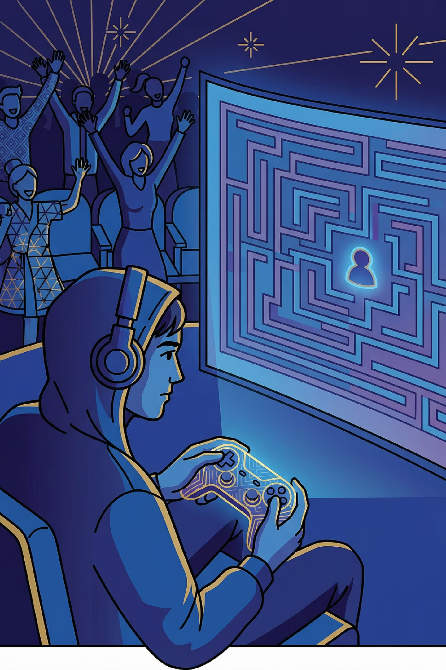
Interactive Live Demonstration
Now, witness the innovation first-hand! We invite you to experience the seamless control and immersive feedback of The iMAZEing Box.
Observe the intuitive motion controls, feel the haptic responses, and see how our PSoC 6 and FreeRTOS architecture come alive.
Ready to Play?

Slide 11



Thank You!
We appreciate your valuable time and attention. We hope this deep dive into The iMAZEing Box has provided insightful perspectives into the potential of modern embedded game system development. Any questions, feel free to ask!
Connect with us for more insights into embedded systems and innovative gaming solutions!

